Slide 1




October 6th 2010 Tornado Outbreak
By: Paige Swenson
Mentors: Dr. Curtis James, Dr. Ronney Schroeder
2020 Arizona Space Grant Symposium
April 18th 2020

Slide 2


Overview
Motivation
Objectives
Methodology
Results
Conclusion

Slide 3

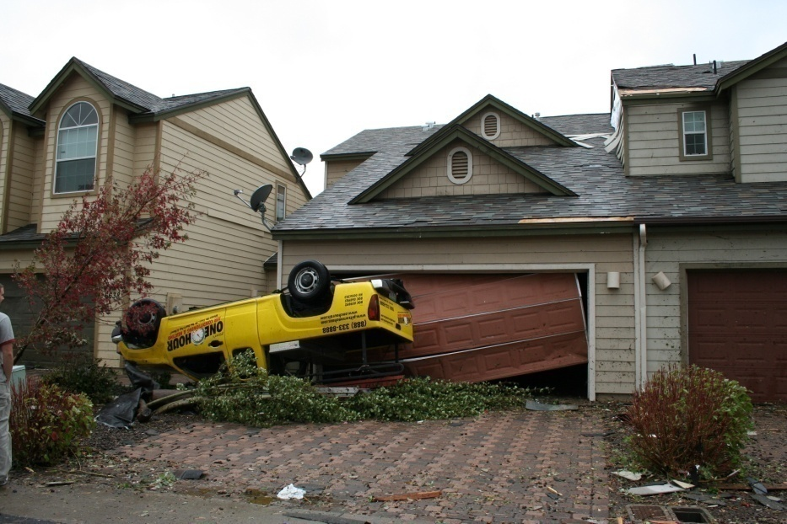
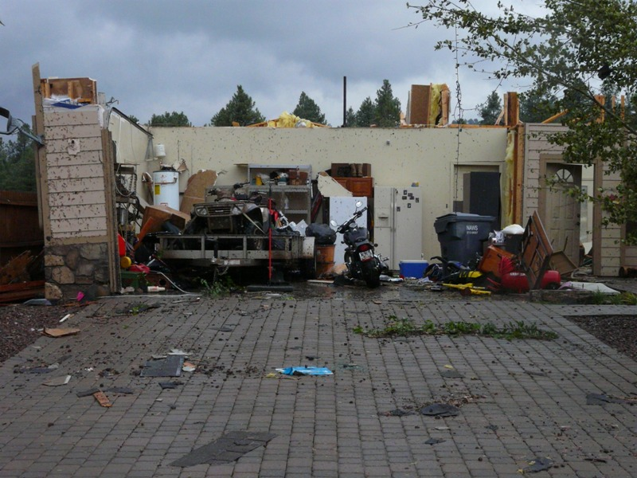
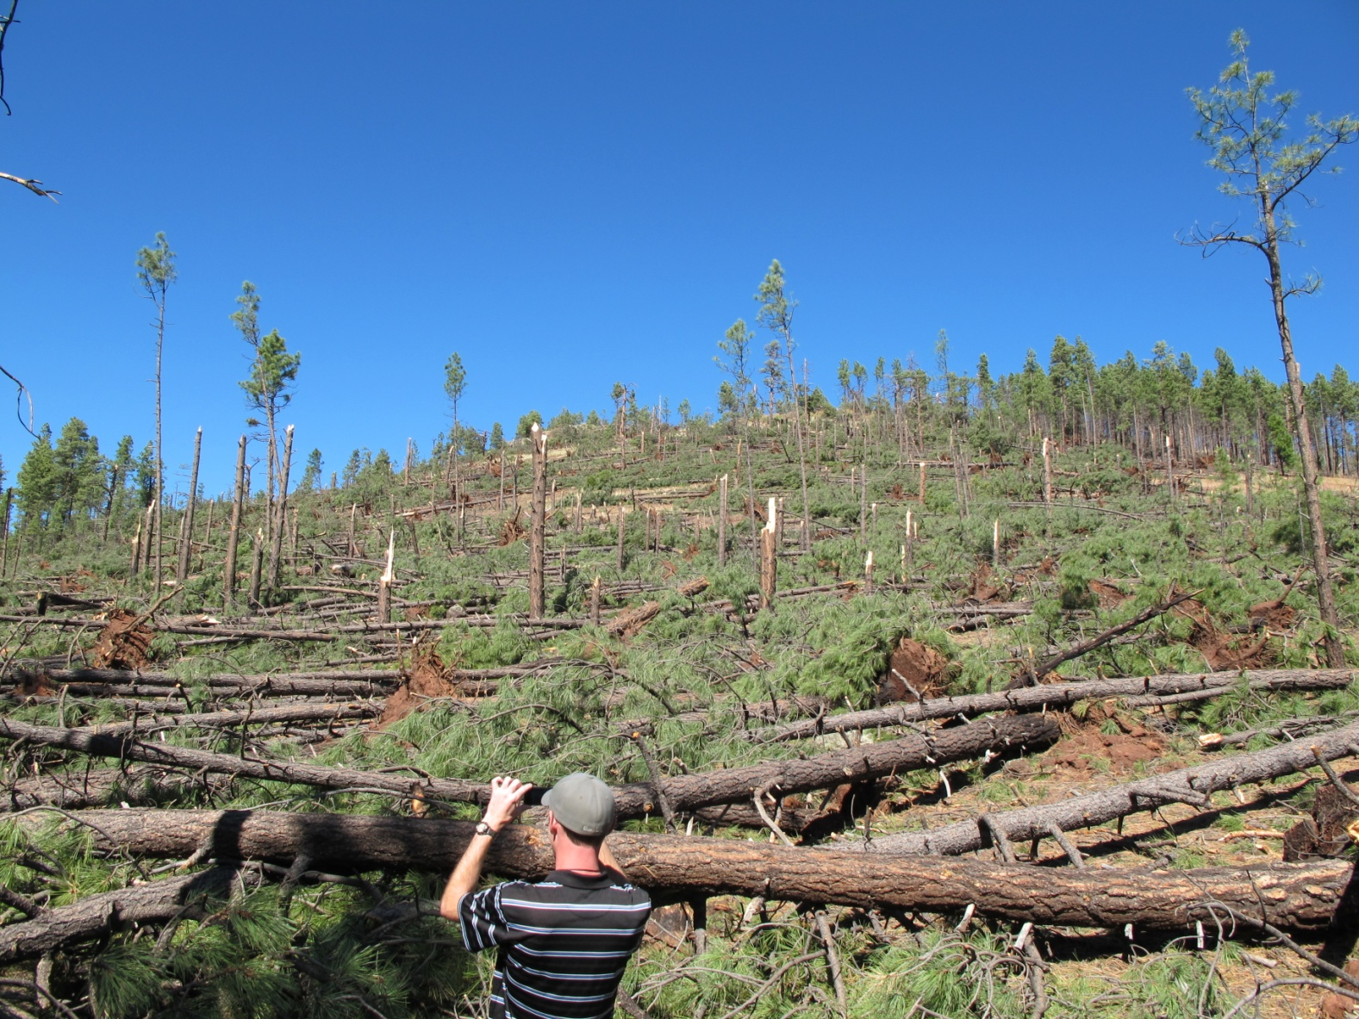
Motivation
Largest tornado outbreak west of Continental Divide
  11 confirmed tornadoes
Rare event that is not well understood by forecasters and needs to be documented
Evidence of strong topographic influences
Source: Klimowski, 2010

Slide 4


Objectives
Explore the physical mechanisms that contributed to the event in terms of:
synoptic-scale storm environment
the topographic influences leading to tornadic development
the statistical correlations between terrain and elevation

Slide 5


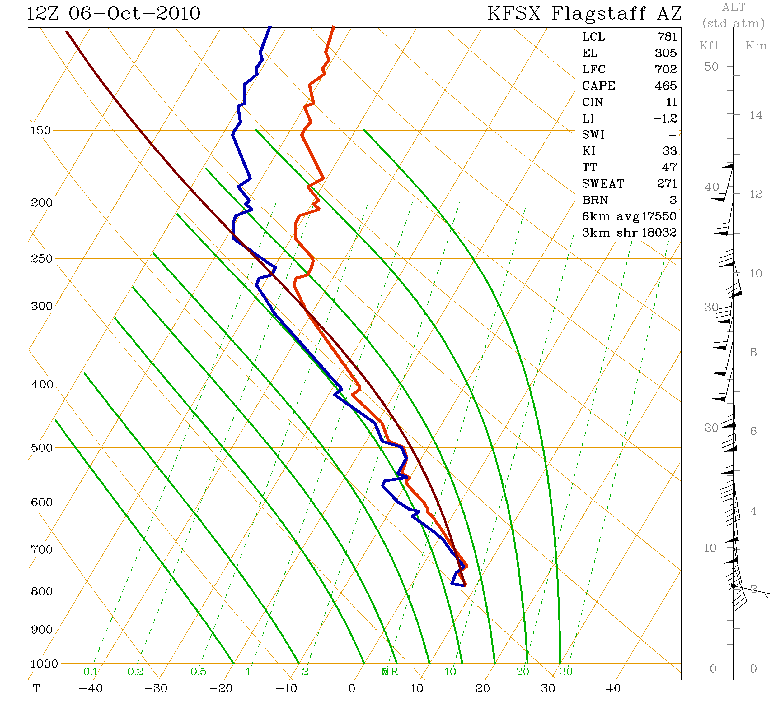
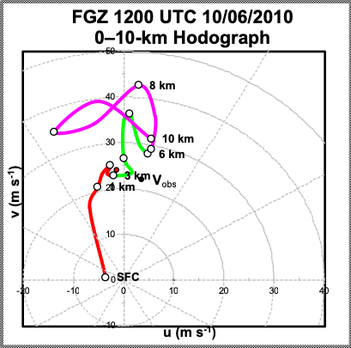
The observed sounding data was from KFSX on 6 Oct 2010 at 12 UTC.
The hodograph was created using the Flagstaff sounding (KFSX)(Klimowski, 2010).

Slide 6


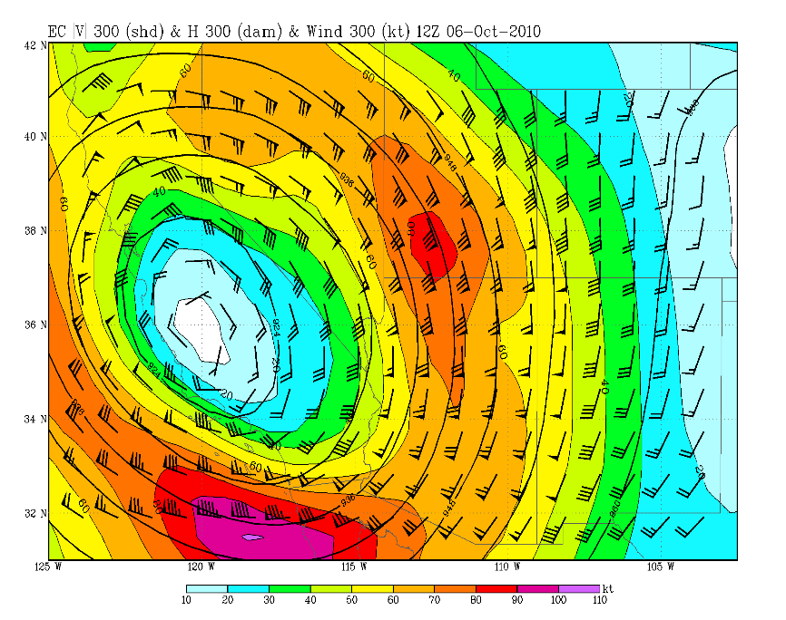
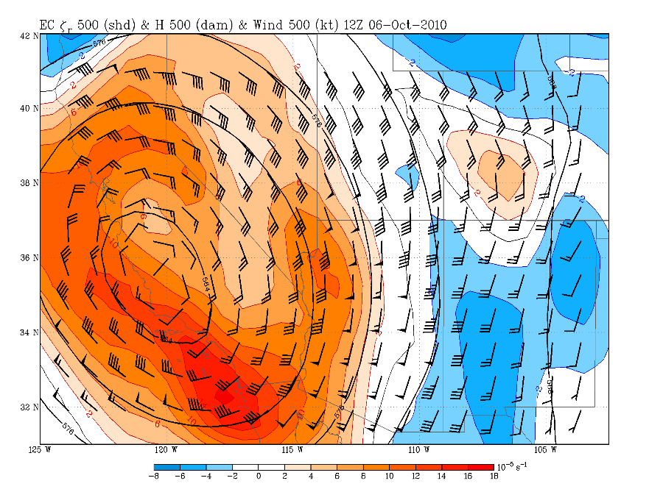
ERA Interim ECMWF reanalysis grids at .75° resolution
The model fields above indicate the presence of a divergent entrance region of an upper jet core ahead of a closed low with vorticity advection and a moist southeasterly low-level jet over northern Arizona. Conditions were ripe for a shallow right- moving supercells.

Slide 7


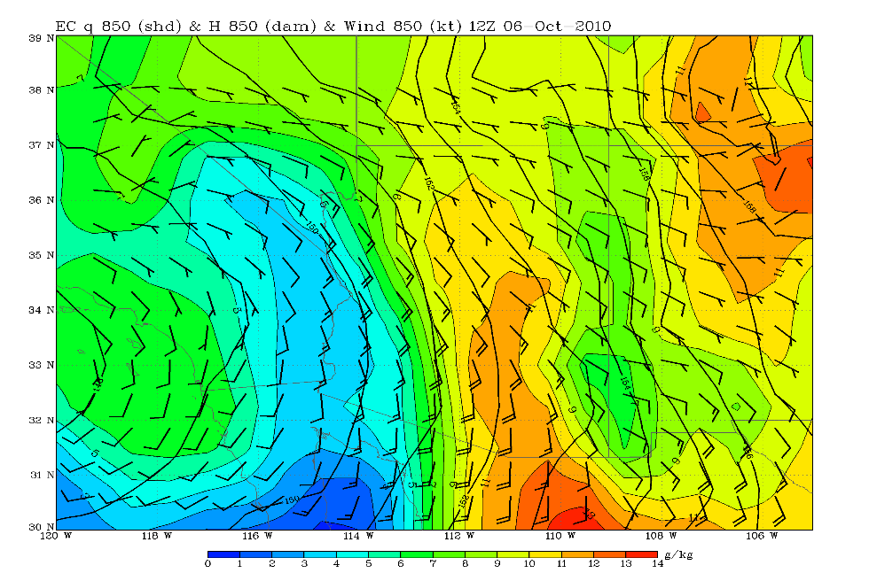
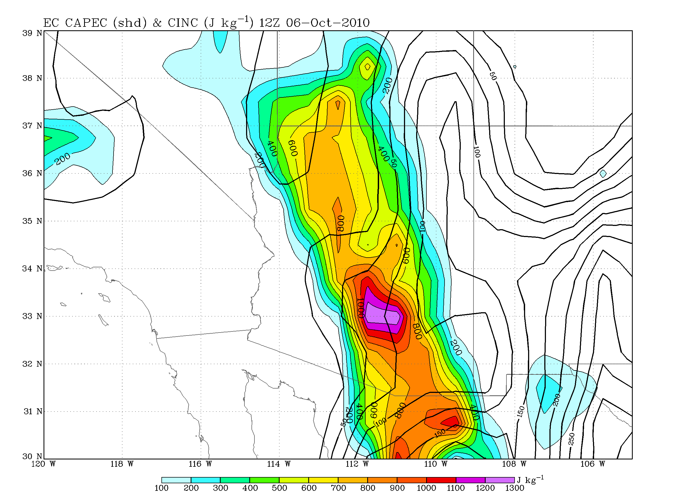
ERA Interim ECMWF reanalysis grids at .75° resolution
The model fields above indicate the presence of low-level southerly winds and a very moist and weak unstable atmosphere.

Slide 8


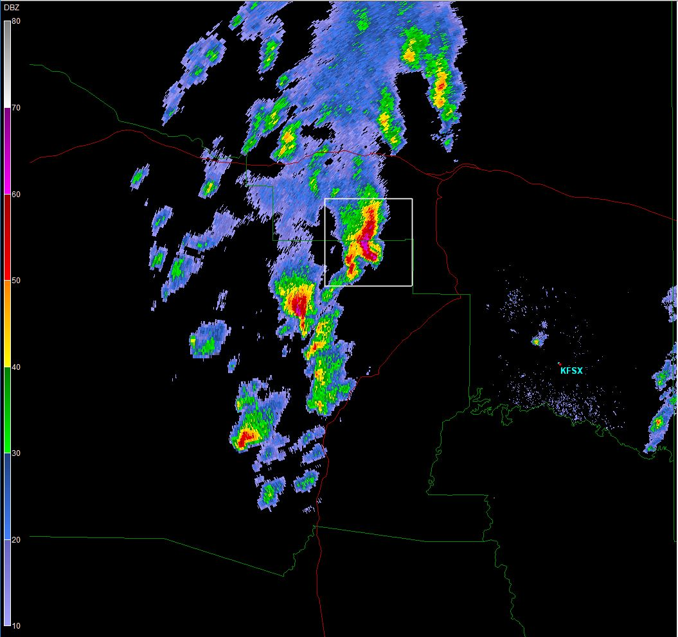
Methodology
Collected full-volume Level II NEXRAD radar volume archives for 6 October 2010
Analyzed them using GR2-Analyst (Source: NCDC)
Cell tracking: Convective cells were tracked if they (1) lasted at least 30 minutes and (2) exhibited a base reflectivity of at least 50 dBZ.
GR2-Analyst 2-D 0.5° PPI plot depicting tornadic supercells

Slide 9


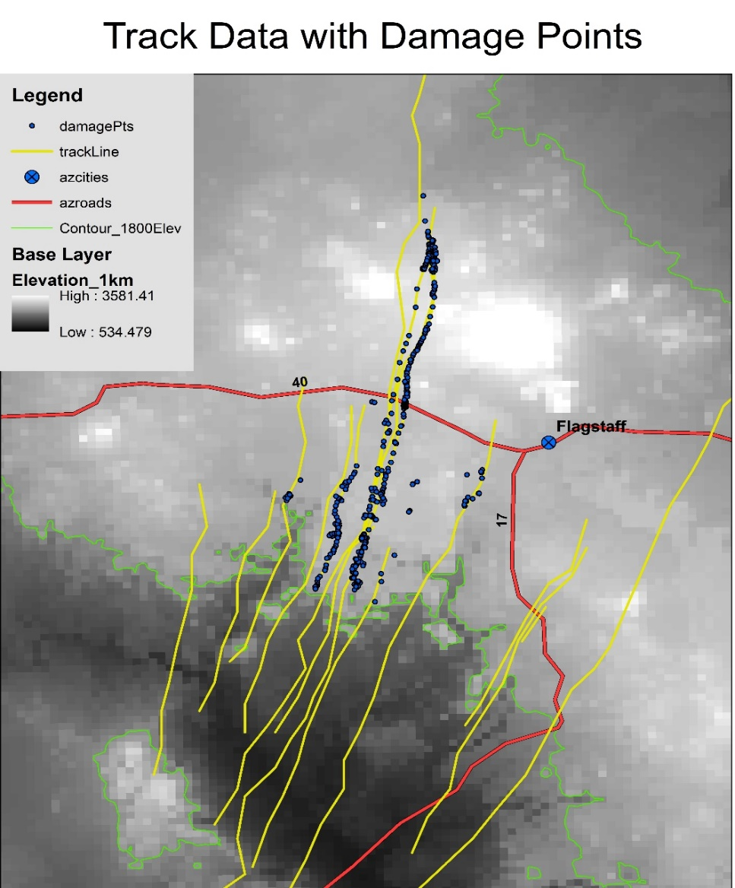
Methodology
Imported collected cell locations into ArcGIS, including latitude, longitude and normalized rotation rate (NROT) data collected at 5-minute intervals for each cell that met the cell tracking criteria.
  NROT normalizes the range dependence of the rotation rate calculated using Doppler winds
Created various maps to examine the influences of terrain elevation and slope on the development of rotation in each cell.
Source: NWS (Klimowski 2010)

Slide 10
Methodology
Imported collected cell locations into ArcGIS, including latitude, longitude and normalized rotation rate (NROT) data collected at 5-minute intervals for each cell that met the cell tracking criteria.
  NROT normalizes the range dependence of the rotation rate calculated using Doppler winds
Created various maps to examine the influences of terrain elevation and slope on the development of rotation in each cell.
Map of tornadic cells over a derived slope map. Points representing five-minute increments of latitude and longitude.
Map of tornadic cells with normalized rotation being depicted based on intensity over the same base map.

Slide 11


Results
Scatter plots comparing NROT vs Elevation
Average Mogollon Rim Elevation represented by the red line
Both trendlines show a weak positive correlation between NROT and Elevation

Slide 12

Results

Slide 13
Results

Slide 14

Conclusions/Future Work
Divergence aloft associated with a jet core ahead of a cut-off low, orographic lifting, a low-level jet, deep saturation, low CAPE and CIN, and strong, deep clockwise shear all evidently favored the formation of this historic outbreak of tornadic supercell thunderstorms.
This event was characterized by a line of shallow fast-moving supercellular thunderstorms that developed on the southwest side of the Mogollon Rim and propagated north north-eastward up and over the rim.
The results of this study all indicate at least a weak positive correlation between thunderstorm rotation in both tornadic and non-tornadic supercells and terrain slope as well as elevation.
Values of r <0.3 are considered weak positive correlations, however, results suggest that the linear relationship explored between X-variable and NROT are significant at the 95-probability level (i.e. p< .05)

Slide 15
Acknowledgments
I would like to express my thanks to the following entities:
Dr. Curtis James for being my research advisor, mentor, chairman, and meteorology professor
Dr. Ronney Schroeder for being my mentor and assisting me with the ArcGIS software
Dr. Brian Klimowski (MIC at NWSFO in Flagstaff, AZ) for providing event images and assistance throughout the project
The NASA Space Grant program at Embry-Riddle for funding this research opportunity

Slide 16
Questions?

